Slide 1
Quantum Spectrum Testing
Ryan O’Donnell
John Wright
(CMU)

Slide 2
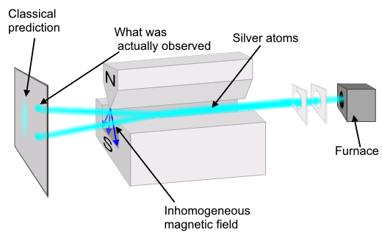
unknown mixed state
You suspect that:
experimental apparatus
, for some fixed
or
Q: How to check your prediction?
A: Property testing of mixed states.
has low von Neumann entropy
or
is low rank

Slide 3
Property testing of mixed states
Proposed by [Montanaro and de Wolf 2013]
Given: ability to generate independent copies of .
Want to know: does satisfy property ?
Goal: minimize # of copies used.
(ignore computational efficiency)

Slide 4
This paper: properties of spectra
spectral properties
not spectral properties
✔
, where is the maximally mixed state
, for some fixed
✗
has low von Neumann entropy
is diagonal
✔
is low rank

Slide 5
Spectral decomp: ,
where .
Spectrum gives a probability distribution over ’s.
Q: Suppose has spectrum . How close is its spectrum to ?
Def:

Slide 6
Quantum spectrum testing
A tester for property is a quantum algorithm given which distinguishes between:
(i) has property .
(ii) for every which has property .
Goal: minimize .

Slide 7
Quantum spectrum testing
A tester for property is a quantum algorithm given which distinguishes between:
(i) has property .
(ii) for every which has property .
equivalent (not obvious)
(ii) for every which has property .

Slide 8
Link to probability distributions
Given , suppose you knew ’s eigenbasis.
Measuring in this basis:
receive w/prob
testing properties of spectrum
given samples from spectrum
probability distribution

Slide 9
Property testing of probability distributions
Probability distribution over .
Empirical distribution -close to after samples.
Can test uniform with
samples. [Pan]
(Testing equality to any known distribution possible in samples [VV])
entropy, support size, etc.

Slide 10
Prior work & our results

Slide 11
Some useful algorithms
Tomography: estimate up to -accuracy.
uses copies
EYD algorithm: estimate ’s spectrum up to -accuracy
uses copies [ARS][KW][HM][CM]
Weak Schur sampling: samples a “shifted histogram” from ’s spectrum.

Slide 12
Our thm:
“New” proof of upper bound.
EYD algorithm requires copies.
EYD algorithm: estimate ’s spectrum up to -accuracy
uses copies [ARS][KW][HM][CM]
Spectrum testing: easy when is quadratic (in )
What about subquadratic algorithms?

Slide 13
A subquadratic algorithm
Q-Bday: distinguish between
is maximally mixed (i.e. )
is maximally mixed on subspace of dim
(i.e. )
Thm:[CHW] copies are necessary & sufficient to solve Q-Bday.
Gives linear lower bounds for testing if:
maximally mixed
is low rank
is low entropy
etc…

Slide 14
A subquadratic algorithm
Q-Bday’:
Q-Bday: distinguish between
is maximally mixed (i.e. )
is maximally mixed on subspace of dim
(i.e. )
Thm:[CHW] copies are necessary & sufficient to solve Q-Bday.
Our Thm: copies are necessary & sufficient to solve Q-Bday’. (+ interpolate between Q-Bday and Q-Bday’)

Slide 15
Property testing results
Thm: samples to test if is maximally mixed.
(i.e. ).
Thm: samples to test if is rank r (with one-sided error).

Slide 16
Weak Schur sampling

Slide 17
Weak Schur sampling: samples a “shifted histogram” from ’s spectrum.
shifted histogram
“ ”
weak Schur sampling
Canonical algorithm:
Given :
1.) Measure using weak Schur sampling
2.) Say YES or NO based
[CHW]: Canonical algorithm is optimal for spectrum testing

Slide 18

Shifted histograms
Given samples from a probability distribution
Histogram: for each sample , place a block in column
Shifted histogram: for each sample , sometimes “mistake” it for one of .
e.g.: given sample
shifted
histogram
histogram

Slide 19
Shifted histograms
Precise pattern of mistakes given by RSK algorithm.
(well-known combinatorial algorithm)
The more samples, the fewer mistakes are made
Shifted histograms look like normal histograms when given many samples

Slide 20
Weak Schur sampling
Given with eigenvalues , WSS is distributed as:
1.) Set
(probability dist. on )
2.) Sample .
3.) Output , the shifted histogram of .
Def: is the output distribution of ’s

Slide 21
Weak Schur sampling, e.g.
Case 1: ’s spectrum is .
sample
histogram
shifted histogram

Slide 22
Weak Schur sampling, e.g.
Case 2: ’s spectrum is .
sample
histogram
shifted histogram

Slide 23
Summary (so far)
Canonical algorithm (WSS)
Outputs (random) shifted histogram
Shifted histogram distribution: combinatorial description
Try to carry over intuition from histogram to shifted histogram

Slide 24
Techniques

Slide 25
Testing mixedness
Distinguish:
1.) ( usually flat)
2.) is -far from ( usually not flat)
Idea:
Notation: # of blocks in column
histogram drawn from unif. dist. is “flat”
maybe shifted histogram is also flat?
Def: is flat if is small

Slide 26
Testing mixedness
Distinguish:
1.) ( usually flat)
2.) is -far from ( usually not flat)
Idea:
Notation: # of blocks in column
histogram drawn from unif. dist. is “flat”
maybe shifted histogram is also flat?
Def: is flat if is small

Slide 27
Testing mixedness
Distinguish:
1.) ( usually flat)
2.) is -far from ( usually not flat)
Idea:
Notation: # of blocks in column
histogram drawn from unif. dist. is “flat”
maybe shifted histogram is also flat?
Def: is flat if is small

Slide 28
Taking expectations
Goal: show is different in two cases
Problem: no formulas for !
For one of our lower bounds, we need to compute
How to take expectations?

Slide 29
Kerov’s algebra of observables
are “polynomial functions” in ’s parameters
Other families of polynomial functions:
, , , polynomials, and more!

Slide 30
Kerov’s algebra of observables
are “polynomial functions” in ’s parameters
Other families of polynomial functions:
, , , polynomials, and more!
gives “moments” of

Slide 31
Kerov’s algebra of observables
are “polynomial functions” in ’s parameters
Other families of polynomial functions:
, , , polynomials, and more!
“geometric” info of

Slide 32
Kerov’s algebra of observables
are “polynomial functions” in ’s parameters
Other families of polynomial functions:
, , , polynomials, and more!
representation theoretic info about

Slide 33
Kerov’s algebra of observables
are “polynomial functions” in ’s parameters
Other families of polynomial functions:
, , , polynomials, and more!
Various conversion formulas between these polynomials
Can compute expectations!
polys
expectation

Slide 34
Conclusion
Import techniques from math to compute “Schur-Weyl expectations” with applications to property testing.
Lots of interesting open problems.

Slide 35
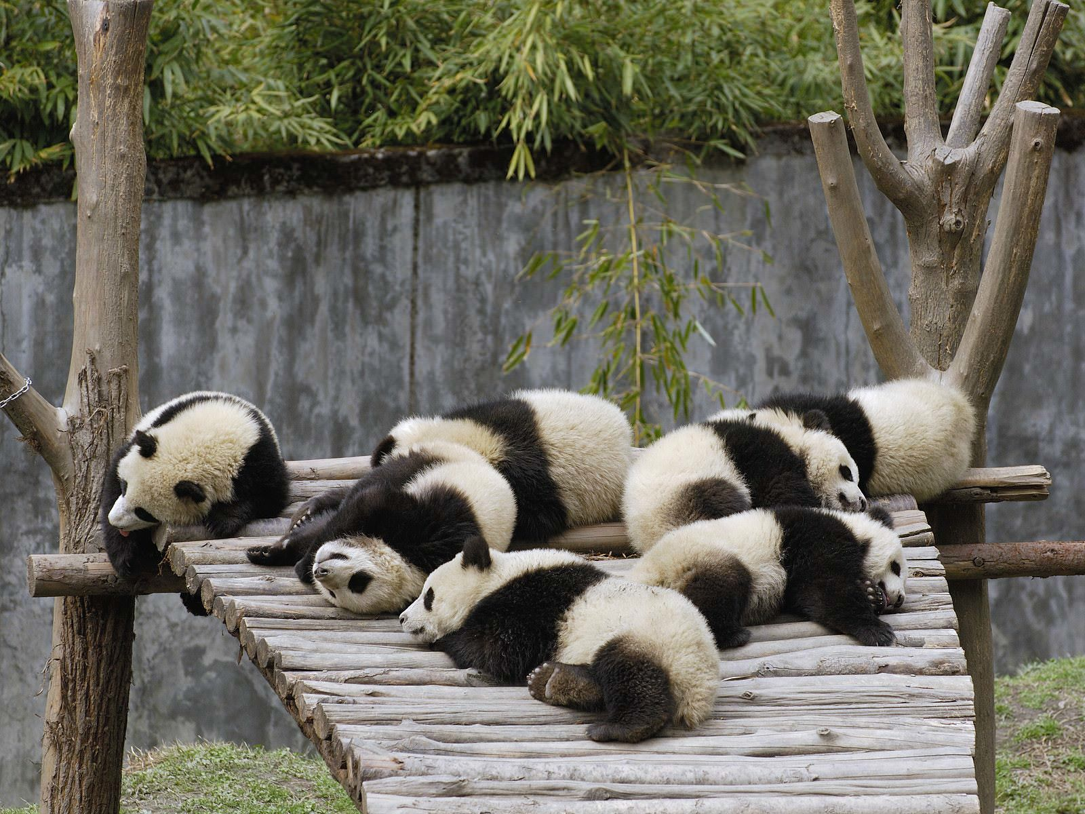
Thanks!

